Slide 1

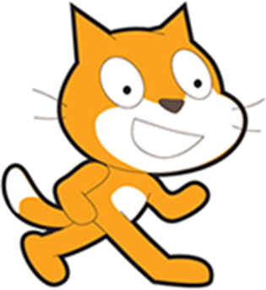
Welcome to Beyond the Basics of
scratch.mit.edu
Warmup: Change Bat Away into Heart Bounce
Review: Script blocks
Introduce: Messages
Introduce: Data
Next step: Introducing Cloning
Wrap up

Slide 2
Goals
Goals for the next 6 weeks
FUN! Learn more of the fun things you can do with Scratch
Learn more of the basics of writing software using Scratch (because Scratch is more fun and easy than just about anything else I’ve seen.)
Topics will include Messages, “More Blocks”, Clones, Variables
Topics may include deeper use of some basic mechanisms, like the drawing panel and importing graphics, sound features, and operations (logical and mathematical)
Hope to also throw in some fun things like oddball features (robots!) video features, alternatives, resources, etc.

Slide 3
What is programming?
Teaching something that is very, very stupid
to do something that seems smart
When programming, remember that computers do exactly what you tell them.

Slide 4
Tonight’s Project: Heart Bounce!
Earlier project was “Bat Away” or “Pong” and after this slide, we’ll change it to “Heart Bounce”
A sprite (bat, heart) moves around the stage
The player uses the paddle to prevent the heart from slipping through.
If the sprite gets past the paddle: GAME OVER
Warm up: Change the graphics
Then: A quick review on script blocks.
First improvement: Game Start state (“Click to begin”)
Second improvement: “Game Over” display (new topic: Messages)
Optional improvement: Score on bounce (Variables)
Final: Show your project!

Slide 5
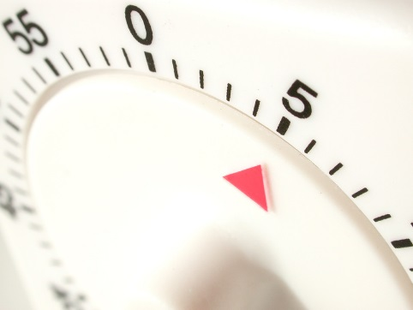
5-minute Warmup! Change Bat Away into Heart Bounce
Go to scratch.mit.edu and sign in if you have an account.
Start with
white belts: http://scratch.mit.edu/projects/17731969/
Change the background
I chose ‘sparkling’ from the built-in backgrounds
Add a heart
In my project, there’s a heart. Move it to your backpack and then replace the bat.
Or, draw or import your own.

Slide 6
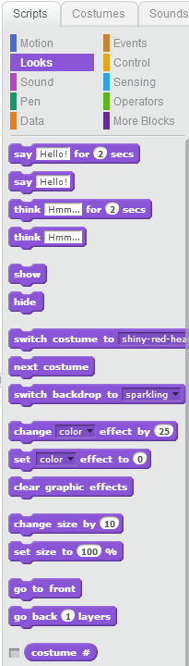
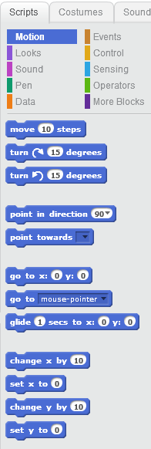
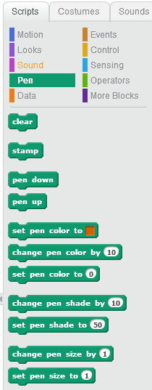
A quick refresher on code blocks
Motion
Pen Drawing
Looks

Slide 7
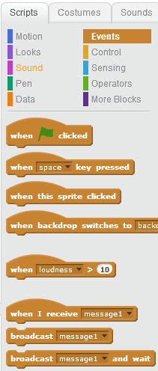
Events
The MOST USEFUL events are
When the Green Flag is clicked
When a keyboard key is pressed
When a sprite is clicked
Today, Introducing messages

Slide 8

“Secret” Messages (events to broadcast and receive)
Sprites don’t normally talk to each other
(think of pong’s ball and paddle)
BUT, you can add your own secret message
Broadcasting and Receiving Messages is better than using a variable to hack in information-passing.
Could it make Heart Bounce better?
The paddle doesn’t know if the sprite goes out of bounds.
The sprite (ball, bat, heart, whatever) DOES know
Let it tell anything that cares!

Slide 9
Heart Bounce – next steps in the puzzle
Game Start screen
I was able to make an opening message that disappeared when the game starts, without sending a message. How? (Tip: when does the heart start moving?)
Game End screen
When the heart makes it past the paddle and touches the , the heart should send a message out. The ‘end of game’ sprite should appear and all others should disappear.
Stuck? Look at http://scratch.mit.edu/projects/13500919

Slide 10
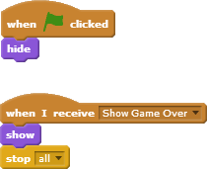
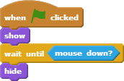
Add a simple Message to Heart Bounce
I added a “Show Game Over” message
What do you think these scripts do (and what sprite(s) are they on?)
What if I suggested there’s a
“Game Over” sprite and a
“Starting Message” sprite?

Slide 11
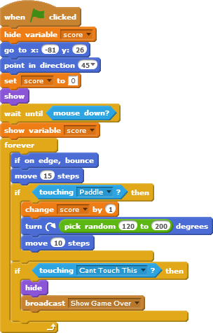
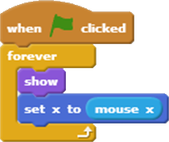
Here are my scripts
Initial code
for the main sprite
(the heart, bat or ball)
On the paddle:
Game loop code in
A forever block
On a Start Game sprite:
On a Game Over sprite:

Slide 12
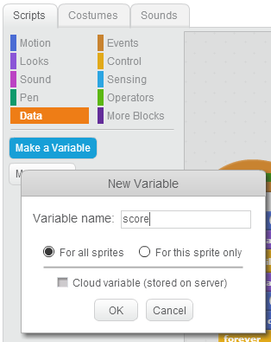
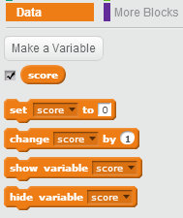
Data. Also called Variables
If you have information that changes, use “variables”
What data might you want in Pong or Bat Away or Heart Bounce?
Smallest change: Add the score (a ‘bounce’ count)
Use the checkbox to have it automatically display
Later, maybe a “lives:” counter

Slide 13
Next steps:
Most games give you multiple lives.
What topics did we cover which would help?
I’m thinking that we might have a variable called “lives”
We set it to ‘3’ on green flag, decrement when the heart gets past the paddle, and send ‘show game over’ when it drops to zero.
How could we ‘refactor’ the code so we can
Restart the game on a mouse click (& change user messages)
We must remove the ‘stop all’
I think I need a new event-message called “Start Game”
I think I could merge all the information sprites (“How to start”, “Game over”) into one sprite. I would make the 2nd costume in the sprite (“Game Over, play again?”)
I think I need a new “Heart Missed” message
I think a 3rd display “You missed. Here’s another heart”
I would put message handlers on that sprite to set the correct costume to match the messages.
I would move nearly all of the existing code in the ‘on Green Flag’ event into a new block (in More Blocks) ‘Start Game’ handler, and have the on green flag handler send a ‘Start Game’ message. (The ‘Show Game Over’ handler / should also

Slide 14
Next Week:
I’ll get rid of the pink background!
We have an ‘unplugged’ activity for kids here at 6:30
We’ll then model that activity in Scratch
We should touch on ‘cloning’

Slide 15
Future topic: cloning
Cloning can turn Pong into Breakout
http://scratch.mit.edu/projects/10101023/
Asteroids is a different game, but once you learn cloning, you know all the Scratch you need to do it. (Do you know all the math you need?)
Here’s the starter version:
http://scratch.mit.edu/projects/14542009/
Here’s a mostly finished version:
http://scratch.mit.edu/projects/17450708/

